Slide 1


Slide 2


Breast Cancer Risk prediction
This project centers on advancing healthcare by strategically enhancing prediction algorithms through the application of machine learning techniques. This project aims to deepen the understanding of breast cancer survival trends and enhance prediction models for patient’s outcomes .
Presented By : R NITIN

Slide 3
INDEX
Introduction
Data Gathering / Data Refinement
Exploratory Data
Analysis
Features Extraction
Methodology
Experimental Results
Conclusion
Appendices and
References

Slide 4

INTRODUCTION
Breast Cancer refers to a group of diseases in which cells in the breast grow uncontrollably. Early detection and Data Science models in medicine can help doctors identify high-risk patients and improve treatment outcomes.
This dataset provides a comprehensive exploration of patient health indicators within a medical context, specifically focusing on factors related to breast cancer risk and prognosis.
The dataset encompasses 34 vital features such as Age of Diagnosis, Tumor Size, Mutation Count, Chemotherapy, Genetic markers, and more.
The target variable, ‘Patient vital status’, signifies the likelihood of an individual having or developing breast cancer.
Breast Cancer Risk Prediction

Slide 5
WORKFLOW
1
6
7
SPLIT TRAIN AND TEST DATA
DATA COLLECTION
MONITOR AND UPDATE
2
5
DATA PREPROCESSING
MODEL SELECTION AND MODEL TRAINING
3
4
EXPLORATORY DATA ANALYSIS
MODEL EVALUATION
5
Breast Cancer Risk Prediction

Slide 6
DATA PREPROCESSING
Handling Missing Values
Removing Duplicates
Data Type Conversion
Feature Encoding
Feature Scaling
We handle missing data through imputation techniques like mean or median for numerical features, and mode or for categorical features, ensuring minimal distortion of patterns in the dataset.
Identified and removed duplicate rows to avoid biased predictions.
Some numerical-looking columns were actually categorical, so they were converted into the appropriate data types.
Converted categorical variables (e.g., hormone receptor status, tumor stage) into numerical values using one-hot encoding for machine learning models.
Applied standardScaler or min-max scaling to ensure features are on a similar scale, improving model performance.
Breast Cancer Risk Prediction

Slide 7


Exploratory Data Analysis
Exploratory Data Analysis (EDA) is the process of analyzing and visualizing a dataset to understand its key characteristics before applying machine learning models. It helps identify patterns, trends, missing values, outliers, and relationships between variables.
Using visuals helped us see the data clearly, understand the clinical data relationship with each other, and pinpoint factors that plays vital role in predictions of Breast Cancer disease.
Insights from EDA help you decide which features are most important for building models and how to prepare them to improve performance.
Some features may be closely related to each other. We use a heatmap to check for strong connections between variables. If two features provide similar information, we may remove one to avoid redundancy.
Univariate analysis looks at one feature at a time to understand its distribution using simple statistics and graphs like histograms and bar charts.
Bivariate analysis examines the relationship between two variables and graph like scatter plots, pair plots. This helps us find important factors that may affect predictions.

Slide 8
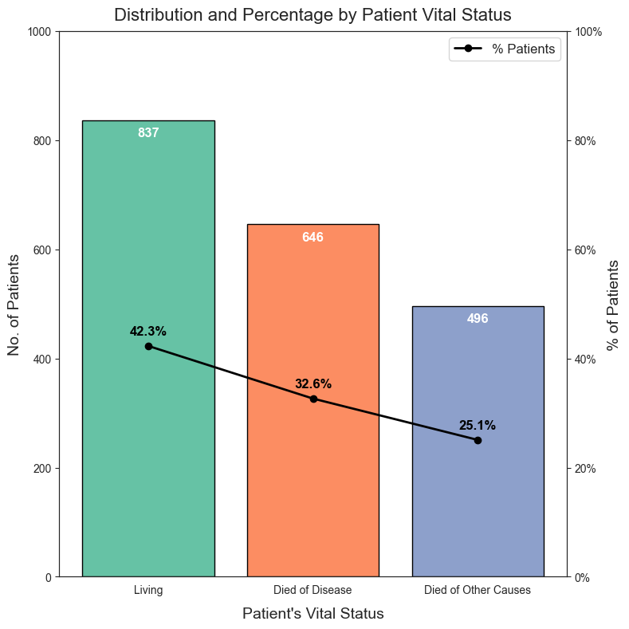
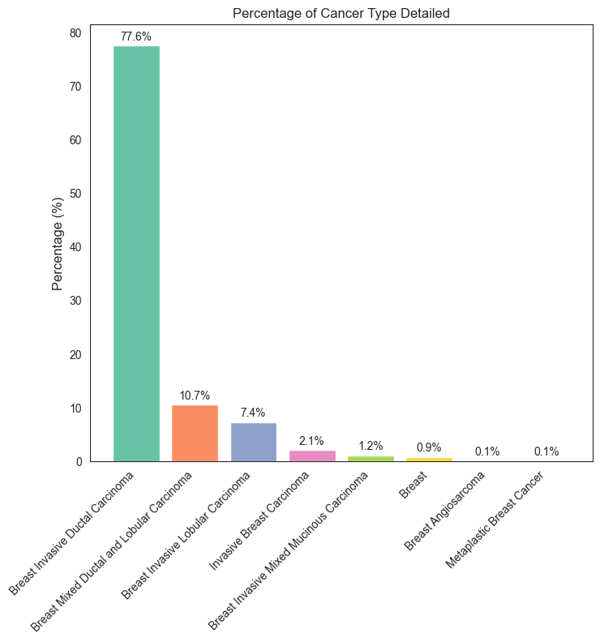
Distribution and Percentage of Patients Vital Status
Percentage of Cancer Type Detailed
Top Cancer Types: The bar graph shows the percentage distribution of patients by detailed cancer type. The tallest bars indicate the most common cancer types in the dataset.
Key Insights: The distribution highlights the most and least common cancer types, providing guidance for targeted research or specialized care. A dominant cancer type may require focused attention or resources.
Rare Cancer Types: Shorter bars represent less common cancer types, which may require further investigation due to their unique challenges or treatment needs.

Slide 9
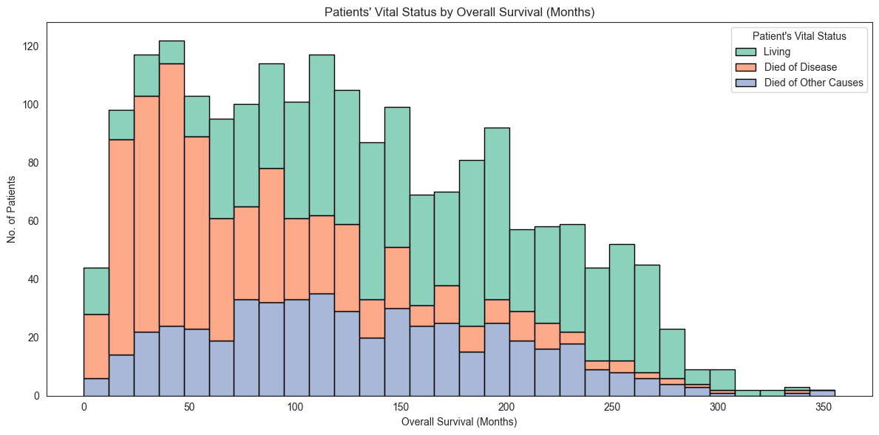
Patient’s Vital Status by Overall Survival ( Months )

Slide 10
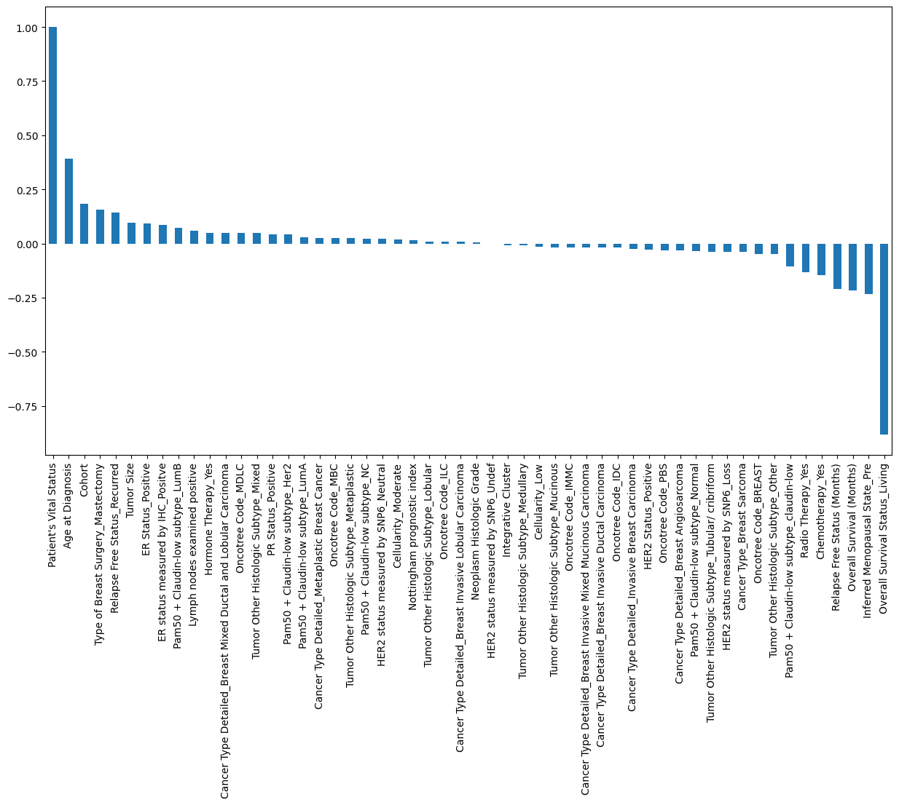
Correlation of each columns by target variable
Age of Diagnosis , Cohort and Tumor size seem to positively correlated with Patient's vital Status . While , Overall Survival Status Living , Overall Survival(Months) , Relapse Free Status(Months) seem to be negatively correlated with Patient's vital Status .
Some variables around the zero-correlation mark (e.g., HER2 status measured by SNP6_Undef and Neoplasm histologic Grade) have minimal or no apparent influence on the target variable, suggesting they may not contribute significantly to the outcome.
We will explore the patterns of the above correlations further before delving into modeling and identifying the important variables.

Slide 11
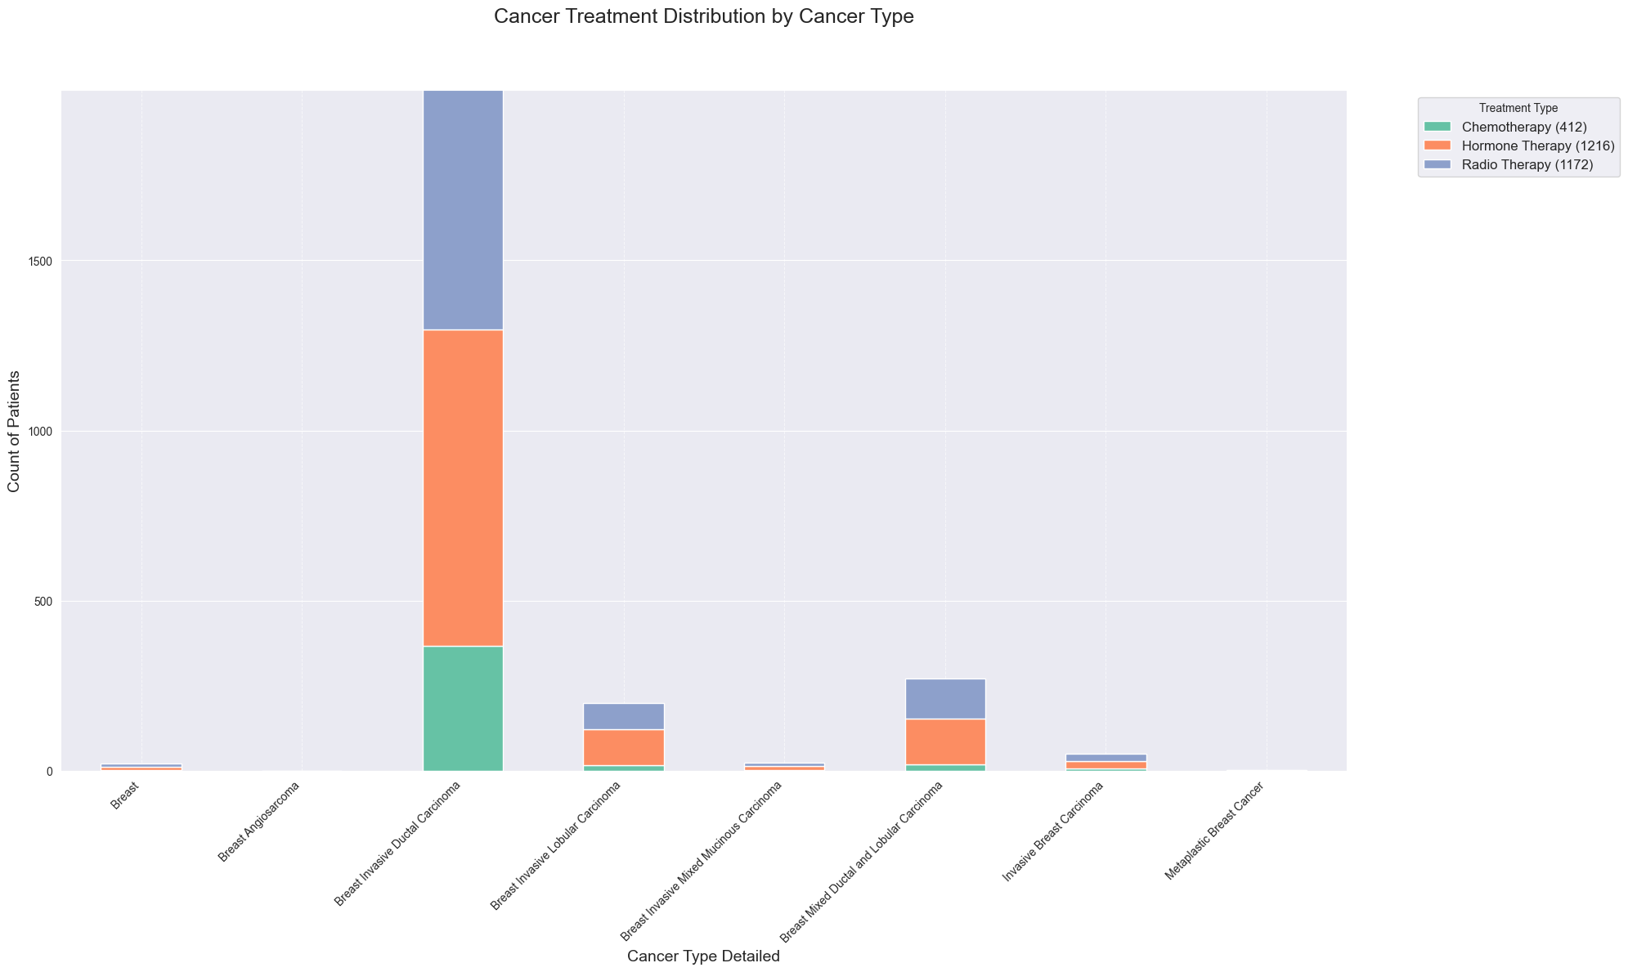
Cancer Treatment Distribution by Cancer Type
1. Treatment Distribution by Cancer Type:
The graph illustrates how different treatments (Chemotherapy, Hormone Therapy, and Radio Therapy) are distributed among various cancer types. Each bar represents a cancer type, with segments showing the number of patients receiving each treatment.
2. Dominant Treatments:
Larger segments indicate the most commonly used treatment for each cancer type. If Chemotherapy consistently appears as the largest segment, it suggests it is the preferred treatment for multiple cancer types.
3. Variation Across Cancer Types:
Some cancer types have a balanced distribution of all three treatments, while others rely more on a specific type. This reflects differences in treatment strategies and protocols for different cancers.
4. Overall Comparison:
The total height of each bar represents the number of patients diagnosed with that cancer type. Taller bars indicate more prevalent cancers with greater treatment demand.
5. Key Insights:
The legend provides total counts for each treatment type across all cancer types, helping identify the most widely used treatment overall. This analysis can guide resource allocation and further research on treatment effectiveness.

Slide 12
TRAIN – TEST SPLIT
We divided the data into training (80%) and testing (20%) sets.
Setting a random state ensures consistent results and using stratify=y maintains a proportional distribution of the target variable in both sets.
SPLITING THE DATA INTO X & Y
We divided the dataset into two parts: X and y.
"X" typically represents the independent Variables, and "y" represents the Dependent (target variable) that we want to predict or understand.

Slide 13
Model Selection
Logistic Regression
Decision Tree
Random Forest
Support Vector Machine (SVM)
K-Nearest Neighbors (KNN)
Logistic Regression is a statistical method used for binary classification. It is valued for its simplicity and effectiveness in modeling the relationship between input variables and the probability of a specific outcome.
Decision Trees are easy to understand and work well for classification problems. They split data into smaller, manageable sections based on the most important features. This algorithm is great for data that has clear categories.
Random Forest is an ensemble learning method that combines multiple decision trees to increase prediction accuracy. It is versatile, performing well for both classification and regression tasks.
SVM is a powerful algorithm used for binary classification. It excels in situations with complex data and creates optimal decision boundaries to separate different categories effectively.
KNN is a simple algorithm that classifies a new data point based on the majority class of its nearest neighbors. It is efficient for both classification and regression, especially when dealing with smaller datasets and clear patterns

Slide 14


Model Evaluation
Experimental Results :
MODEL’S | ACCURACY % | PRECISION % | RECALL % | F1-SCORE %
Logistic Regression | 96.90 | 97.07 | 96.90 | 96.88
Random Forest | 96.90 | 97.17 | 96.90 | 96.87
Decision Tree | 96.90 | 97.17 | 96.90 | 96.87
K-Nearest Neighbours (KNN) | 80.56 | 80.31 | 80.56 | 79.91
Support Vector Machine (SVM) | 96.90 | 97.17 | 96.90 | 96.87
Support Vector Machine:
Support Vector Machine excels with 96.90% accuracy, balanced precision (97.17%) and recall (96.90%), showcasing superior overall classification performance.
Random Forest & Decision Tree Consistency:
Both algorithms maintain 96.90% accuracy, with Decision Tree having higher precision (97.17%) and Random Forest higher recall (96.90%).
Logistic Regression & K-Nearest Neighbours :
LR achieves 96.90% accuracy and high precision (97.07%) but lower recall (96.90%). In the same time KNN achieves 80.56% accuracy and high recall (80.56%) but lower precision (80.31%) .
Understanding
Precision: The accuracy of the model when it claims to have found something.
Recall: Recall: The ability of a model to find all the relevant cases
F1 Score: A balance between recall and precision, useful when both false positives and false negatives need to be minimized.

Slide 15



Conclusion
Key Findings
Logistic Regression model demonstrated the highest accuracy of 97% in predicting breast cancer risk
The study utilized a breast cancer dataset and applied multiple machine learning models using Jupyter Notebook.
All models showed strong performance, with accuracy ranging from 80% (KNN) to 97% (Logistic Regression).
Limitations
The study is based on a single, small dataset, which may limit its generalizability to broader populations.
The model primarily considers clinical and demographic factors, overlooking key lifestyle and genetic risk contributors to breast cancer.
The model needs extensive validation on independent test datasets to ensure real-world applicability.
Future research
To enhance accuracy and reliability, future research should focus on ensuring the model is robust, generalizable, and interpretable. Evaluating the impact of missing, duplicate, or anomalous data on model performance is crucial. Developing effective strategies to manage these challenges will strengthen the model’s overall effectiveness and decision-making capabilities.

Slide 16
Thank You!

